Slide 1
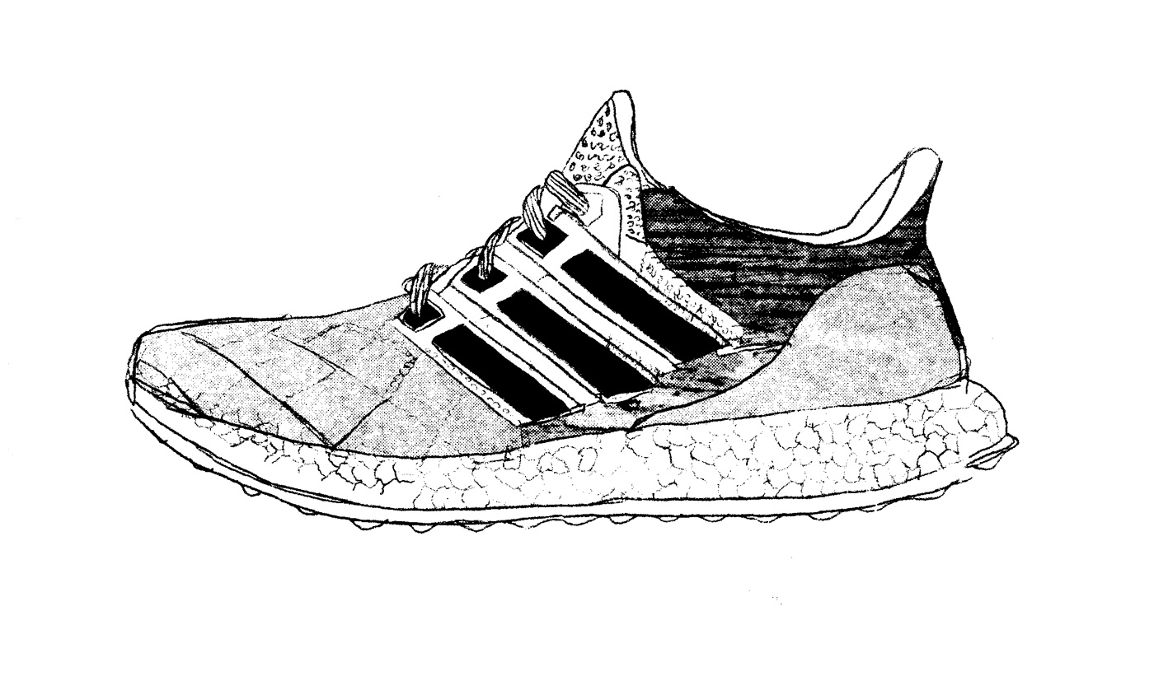

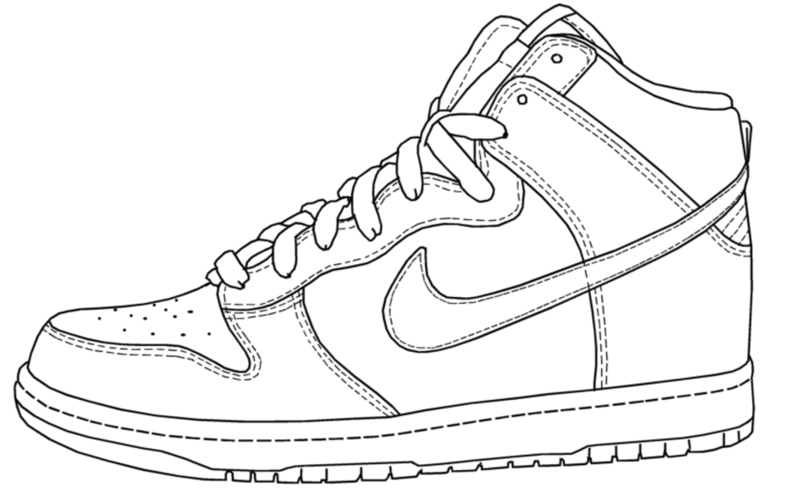
Project 1: SneakerHub
Kevin Tse /
Julie Huang
WDI 37

Slide 2
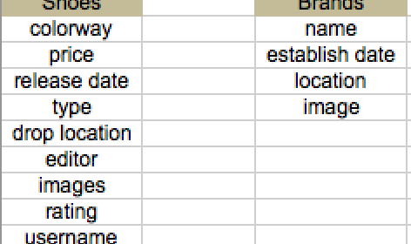

Slide 3
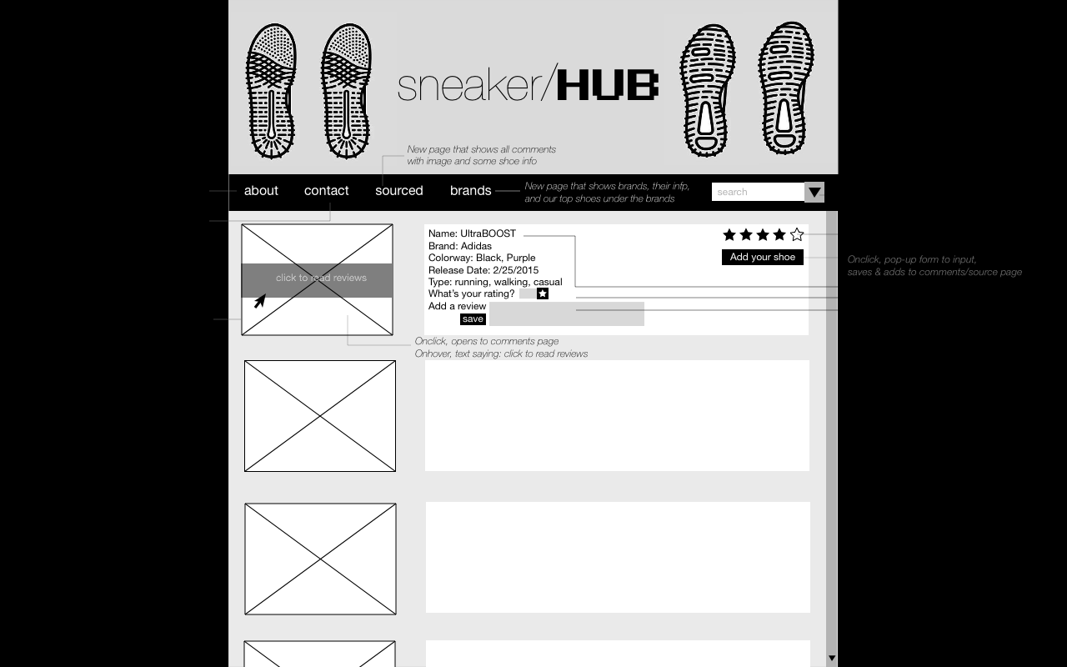
WIREFRAMES: Main Page

Slide 4
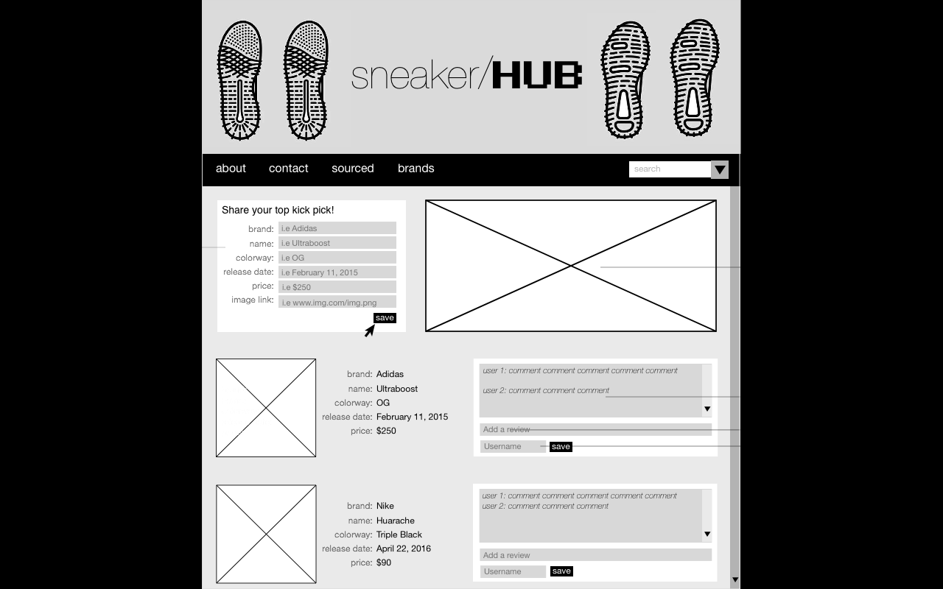
WIREFRAMES: Source Page

Slide 5
WIREFRAMES: Brands Page

Slide 6
FRONT END
HTML
CSS
Materialize
App.js
Appsource.js

Slide 7
BACK END
Server
AJAX
Models
Shoe.js
Brand.js
Index.js
Seed

Slide 8
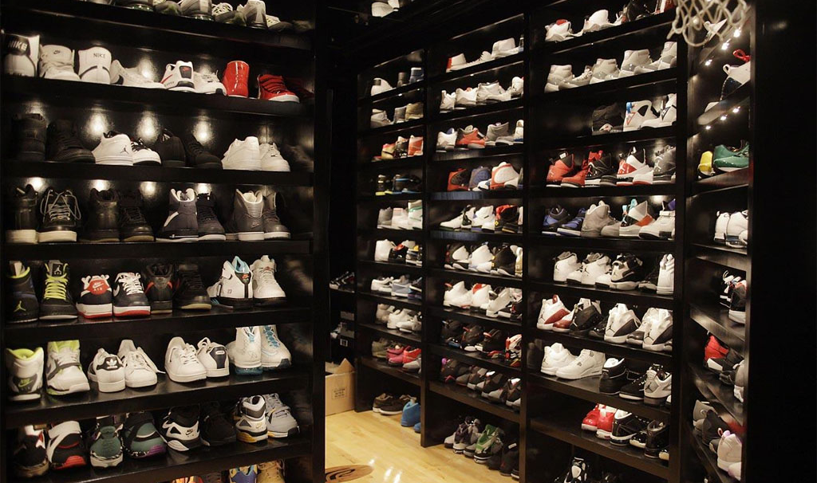
QUESTIONS?

